Slide 1
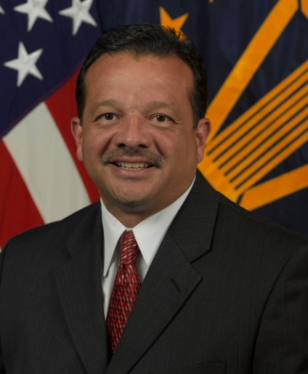
BIOGRAPHY
Office of the Under Secretary of Defense for
JOSE M. GONZALEZ
Acquisition & Sustainment
Executive Director, Human Capital Initiatives
Mr. Jose Gonzalez has over thirty three years of public service experience. He has been with the Office of the Secretary of Defense (OSD) since 2001 and with the Department of Defense (DoD) since 1985. He was appointed to the Senior Executive Service in June 2010 and is currently serving as the Executive Director for Human Capital Initiatives. In this position, he advises the Under Secretary of Defense for Acquisition and Sustainment on matters relating to policy and governance of the DoD-wide 169,000 member acquisition workforce. Mr. Gonzalez executes statutory responsibilities of the Defense Acquisition Workforce Improvement Act, policy and execution for the 40,000 participants in the Civilian Acquisition Workforce Personnel Demonstration Project, and management of the $400M annual Defense Acquisition Workforce Development Fund.
Mr. Gonzalez started his career in the defense industry at Vitro Corporation, Silver Spring, Md., as a software engineer for the U.S. Navy’s TARTAR Mk 14 Weapons Direction System. In 1989, he entered federal government service at the Naval Surface Warfare Center (NSWC), Dahlgren, Va. While at NSWC, he served as Technical Direction Agent and Systems Engineer for the U.S. Navy’s Mk 41 Vertical Launching System, facility manager for the Navy’s Program Assurance Facility, Head of the Advanced Launching Systems Group, and Head of the Advanced Control Systems Engineering Branch. During this time, he took on two developmental assignments, first as the Combat Systems Department Head for the U.S. Navy’s Smart Ship Project and second as a Staff Specialist in OSD, supporting the office of Naval Warfare. While in OSD, Mr. Gonzalez served as a staff specialist, then served as the Deputy Director for Land Warfare and Munitions and later as Deputy Assistant Secretary of Defense for Tactical Warfare Systems, within the Office of the Under Secretary of Defense for Acquisition, Technology and Logistics, where he was responsible for major platform and weapon system acquisition oversight and technology advancement across the air, land, naval, and electronic warfare portfolios – investments valued at over $70 billion annually.
Mr. Gonzalez received a Bachelor of Science degree in Electrical Engineering from the University of Maryland in 1985. He earned a Masters Degree in Public Administration from Virginia Polytechnic Institute and State University in 2005. He is a graduate of the Leadership for a Democratic Society program from the Federal Executive Institute.
Mr. Gonzalez is a resident of Charles County, Maryland, where he lives with his wife Margie and nearby daughters Jessica, Holly, and grandchildren.

